Slide 1

NB Open Data Checkup
Presented by
Team Abracadata
November 2018

Slide 2
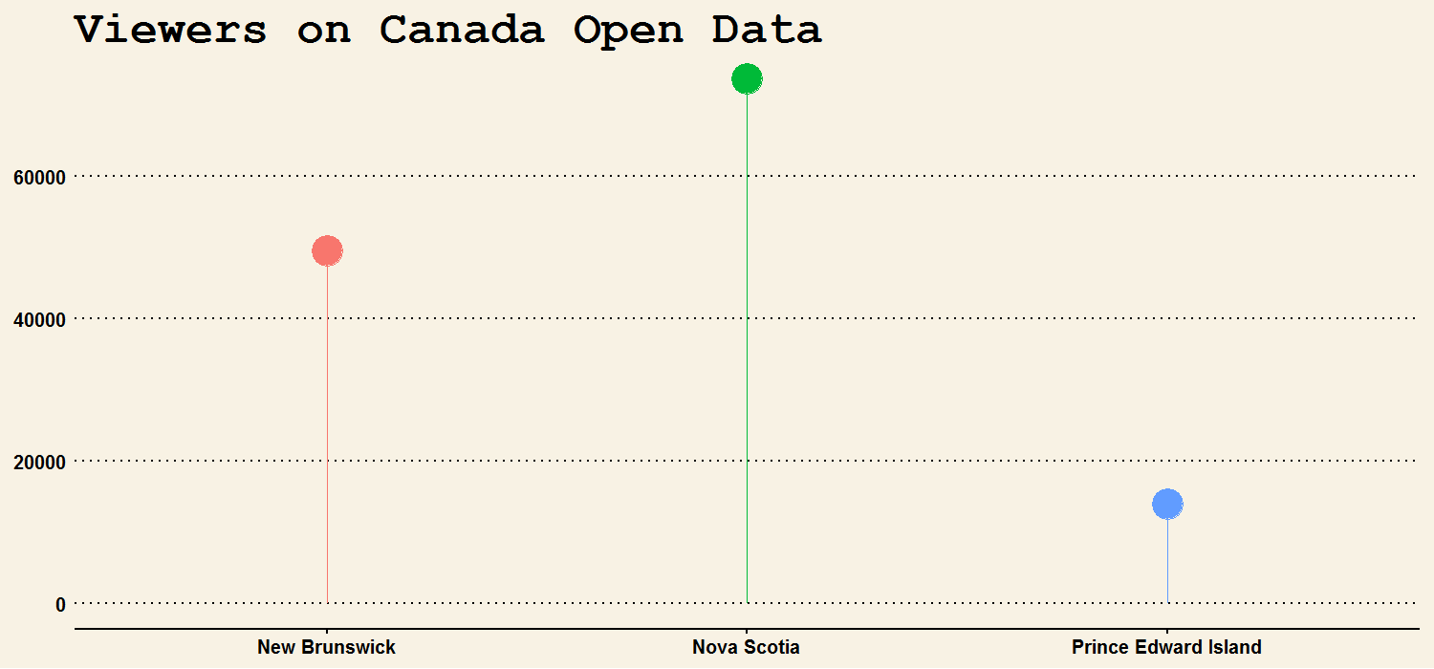
New Brunsiwckers Want Open Data
73,692
49,483
13,933

Slide 3
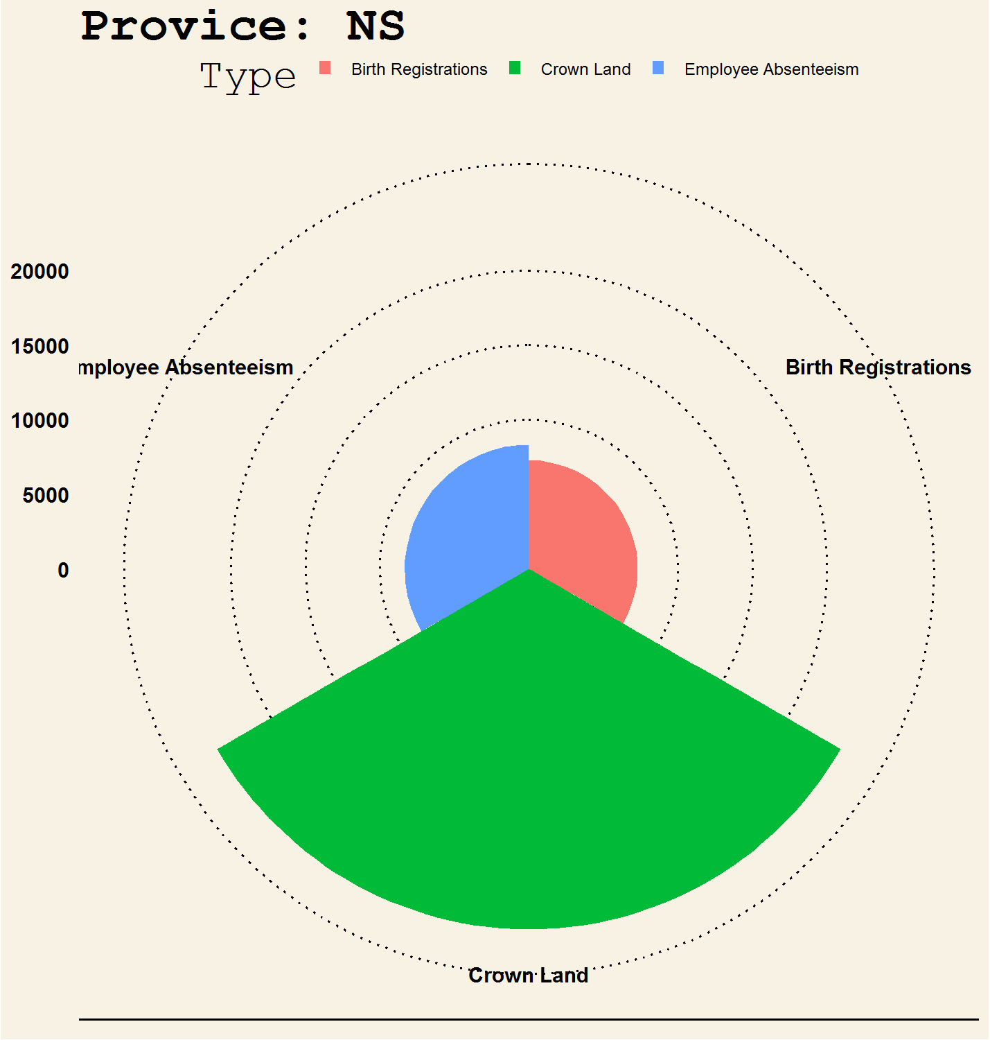
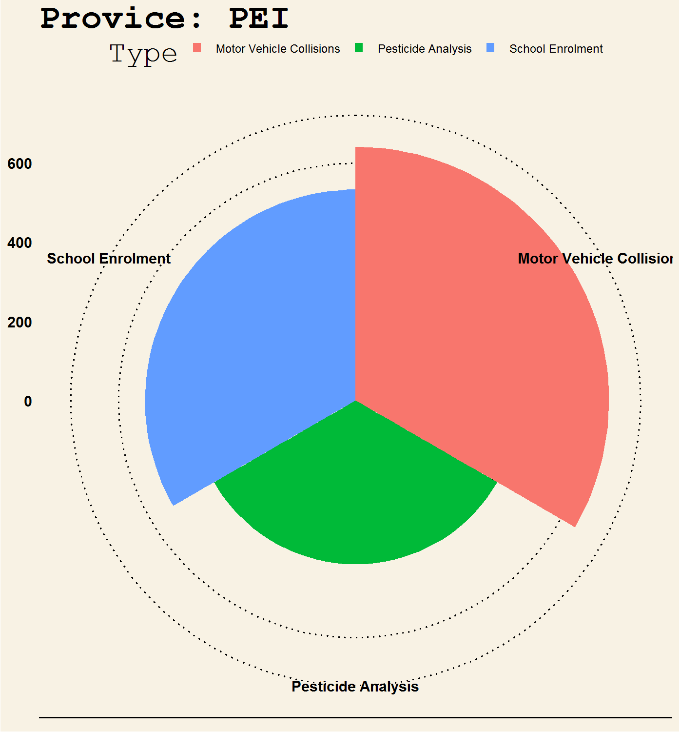
What Data Does Maritimers Want?

Slide 4
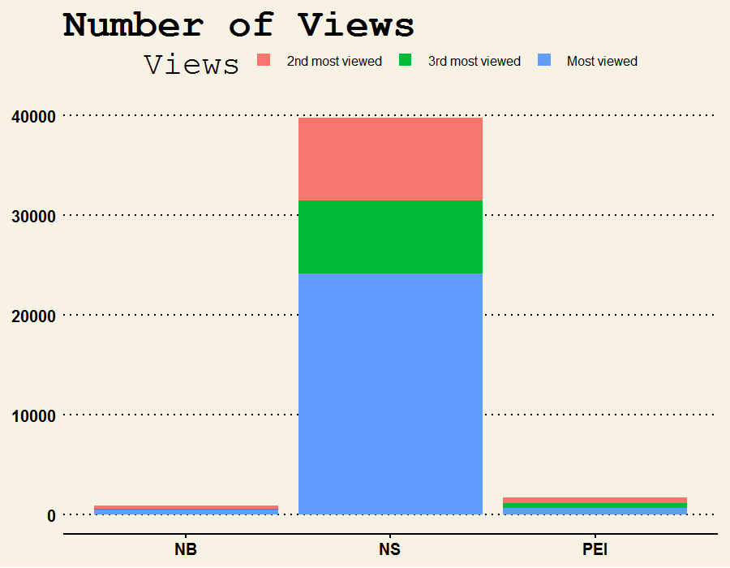
New Burnswick Open Data
NB Open Data
Is not very engaging
Compare with PEI
NB Population is 5 times PEI’s
NB views is 50% PEI’s
Compare with NS
NB Populations is 4/5 of NS’s
NB views is 5% NS’s

Slide 5
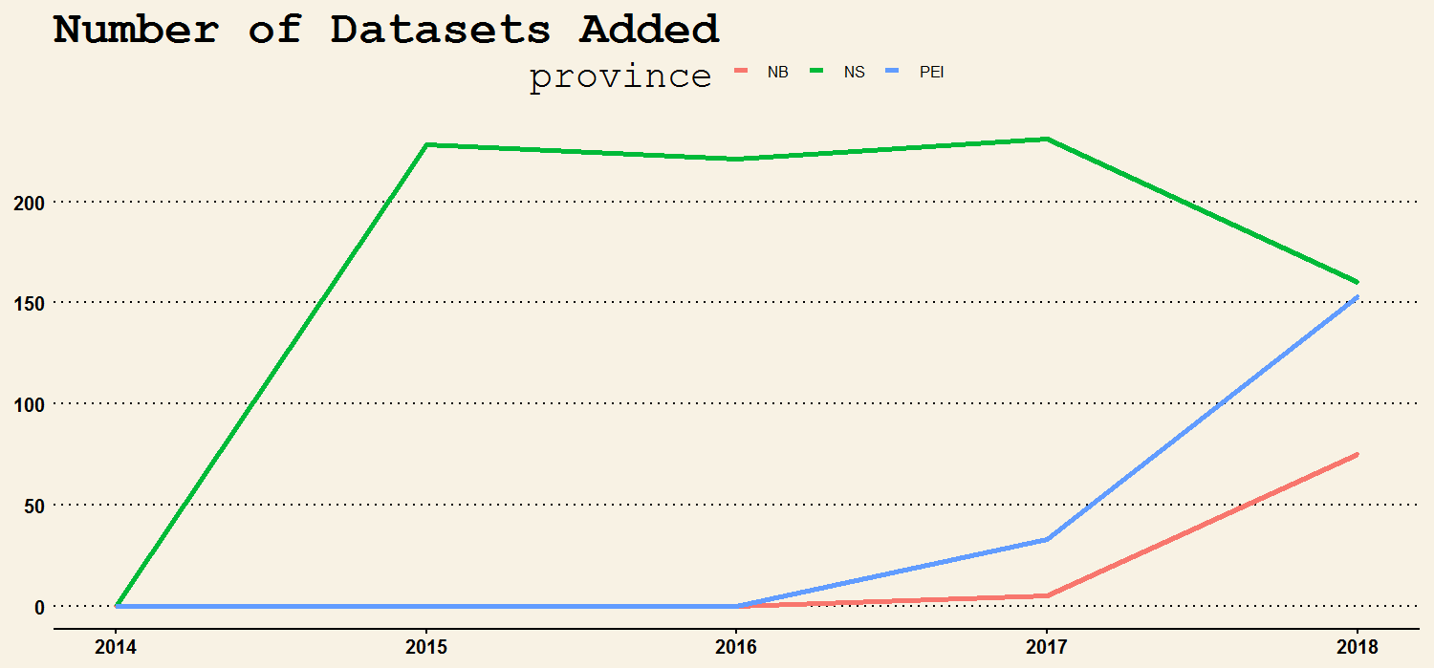
New Burnswick Open Data
Over 70 datasets added so far in 2018

Slide 6
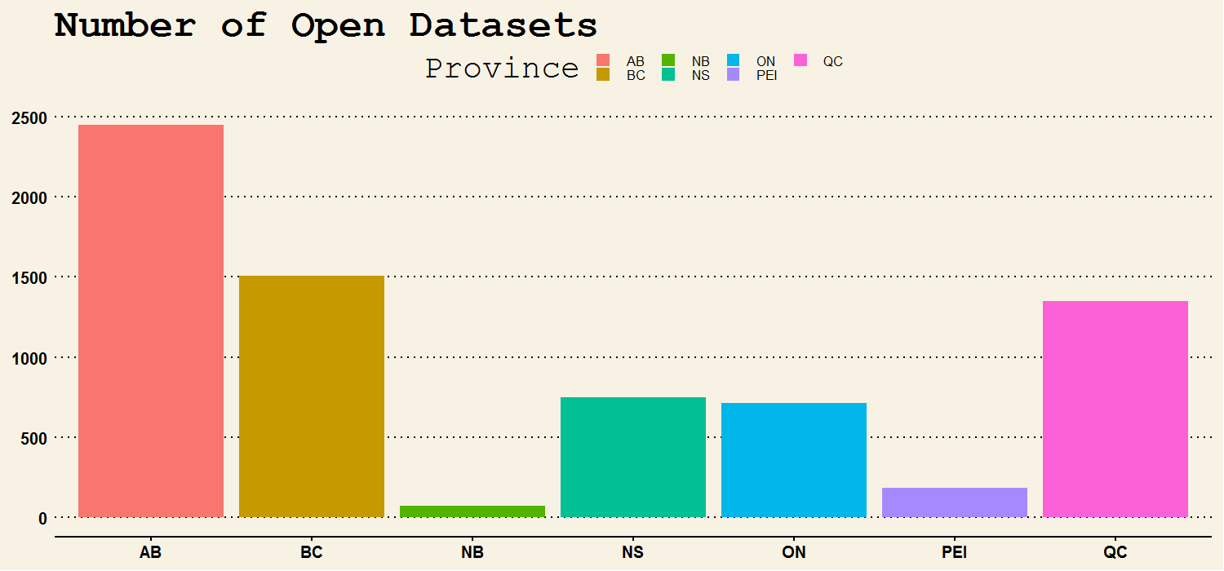
New Burnswick Open Data
We don’t have much open data

Slide 7
Conclusion & Recommendation
Canadian want open data, New Brunswickers want open data
We are doing better
Open data NB has over 70 new datasets added
However, the datasets are not connected to each other
We still have the fewest datasets in Canada
Recommendations
Add data description to existing datasets
Integrate NB open data portal with Fredericton, Saint John, and Moncton data portal
Promote NB open data portal to New Brunswickers

Slide 8

THANK YOU!
Team Abracadata
November 2018

